Slide 1
Urinary catheterization
Student name :
Nourhan Elsaid Darwish
ID : 50815312
Doc. Hoda

Slide 2
What are urinary catheters?
A urinary catheter is a hollow, partially flexible tube that collects urine from the bladder and leads to a drainage bag. Urinary catheters come in many sizes and types. They can be made of:
rubber
plastic (PVC)
silicone

Slide 3
Why are urinary catheters used?
A doctor may recommend a catheter if you:
can’t control when you urinate
have urinary incontinence
have urinary retention

Slide 4
The reasons why you may not be able to urinate on your own can include:
blocked urine flow due to bladder or kidney stones, blood clots in the urine, or severe enlargement of the prostate gland
surgery on your prostate gland
surgery in the genital area, such as a hip fracture repair or hysterectomy
injury to the nerves of the bladder

Slide 5
spinal cord injury
a condition that impairs your mental function, such as dementia
medications that impair the ability of your bladder muscles to squeeze, which causes urine to remain stuck in your bladder
spina bifida

Slide 6
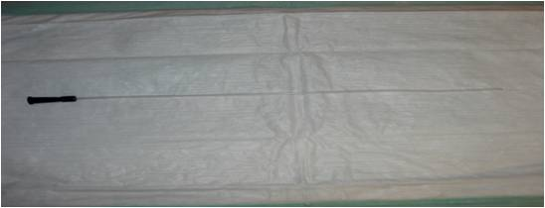
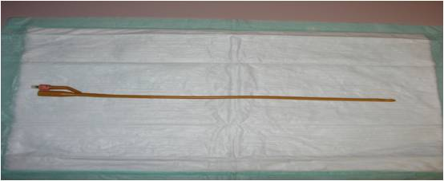
Types and sizes of catheters
Straight-single use catheters
Have a single lumen with a small 1¼ cm opening.
2-way Foley catheters (retention catheters)
Have an inflatable balloon that encircles the tip near the lumen or opening of the catheter.

Slide 7
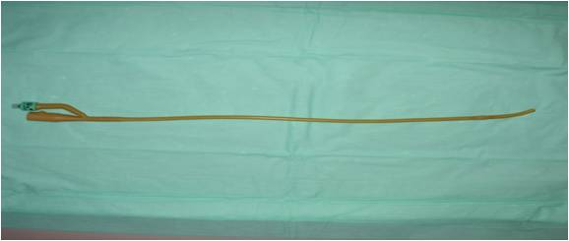
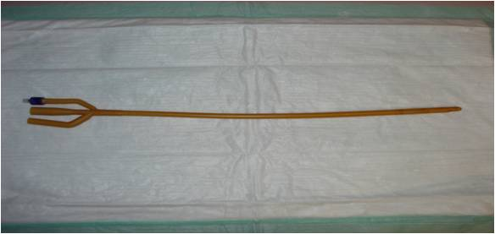
Curved or Coude
Catheters have a rounded curved tip (elbowed) used in older male patients with enlarged prostates which partially obstruct the urethra.
3-way Foley catheter
Often called retention catheter, they have 2 or 3 lumens that encircle the body of the catheter. One lumen drains the urine through the catheter into a collection bag. The second lumen holds the sterile water when the catheter is inflated and is also used to deflate the balloon. The third lumen may be used to instill medications into the bladder or provide a route for continuous bladder irrigation.

Slide 8
What are the potential complications of urinary catheters?
According to an article in BMC Urology, indwelling urinary catheters are the leading cause of healthcare-associated urinary tract infections (UTIs). Therefore, it’s important to routinely clean catheters to prevent infections.
The symptoms of a UTI may include:
fever
chills
headache
cloudy urine due to pus
burning of the urethra or genital area
leaking of urine out of the catheter
blood in the urine
foul-smelling urine
low back pain and achiness

Slide 9
Other complications from using a urinary catheter include:
allergic reaction to the material used in the catheter, such as latex
bladder stones
blood in the urine
injury to the urethra
kidney damage (with long-term indwelling catheters)
septicemia, or infection of the urinary tract, kidneys, or blood

Slide 10
Preventing infection!
Everyday care of catheter and drainage bag is important to reduce the risk of infection.[11] Such precautions include:
Cleansing the urethral area (area where catheter exits body) and the catheter itself.
Disconnecting drainage bag from catheter only with clean hands
Disconnecting drainage bag as seldom as possible.

Slide 11
Keeping drainage bag connector as clean as possible and cleansing the drainage bag periodically.
Use of a thin catheter where possible to reduce risk of harming the urethra during insertion.
Drinking sufficient liquid to produce at least two liters of urine daily
Sexual activity is very high risk for urinary infections, especially for catheterized women.

Slide 12
There is no clear evidence that any one catheter type or insertion technique is superior than another in preventing infection.
Recent developments in the field of the temporary prostatic stent have been viewed as a possible alternative to indwelling catheterization and the infections associated with their use.

Slide 13
When To Call A Professional?
In someone with a urinary catheter, the following symptoms can be signs of infection or other complications. Contact your doctor or home-care nurse if you have any of these symptoms:
Fever, with or without chills
Pain in the abdomen, flank or lower back
Urine that smells foul or unusually strong
Urine that is thick, cloudy or tinged with blood
(Indwelling catheter) Little or no output of urine into the drainage bag, in spite of attempts to irrigate the catheter
(Indwelling catheter) Leakage of urine past the catheter

Slide 14
Self-catheterisation
If you have been taught to use intermittent catheters, you should insert them several times a day to drain urine into a toilet or bag. These catheters are usually designed to be used once and then thrown away.
How often intermittent catheters need to be used differs from person to person. You may be advised to use them at regular intervals spaced evenly throughout the day, or only when you feel you need the toilet.

Slide 15
Living with a urinary catheter
It’s possible to live a relatively normal life with a long-term urinary catheter, although it may take some getting used to at first.
Before being discharged from hospital, a specialist nurse will give you detailed advice about looking after your catheter.

Slide 16
How to care for a urinary catheter?
One-time use catheters and reusable catheters are available. For reusable catheters, be sure to clean both the catheter and the area where it enters the body with soap and water to reduce the risk of a UTI. One-time use catheters come in sterile packaging, so only your body needs cleaning before inserting the catheter.
You should also drink plenty of water to keep your urine clear or only slightly yellow. This will help prevent infection.
Empty the drainage bag used to collect the urine at least every eight hours and whenever the bag is full. Use a plastic squirt bottle containing a mixture of vinegar and water or bleach and water to clean the drainage bag.

Slide 17
References
Hanno, Philip M.; Wein, Alan J.; Malkowicz, S. Bruce. (2001). Clinical manual of urology.. McGraw-Hill Professional. p. 78.
Elroy D. Kursh (1987). Urology: Problems in Primary Care. Medical Economics Books. ISBN 9780874894196.
Black, Mary Ann (1994). Medical nursing (2nd ed.). Springhouse, Pa.: Springhouse Corp. p. 97. ISBN 0-87434-738-6. LCCN 94035389.
Lam, TB; Omar, MI; Fisher, E; Gillies, K; MacLennan, S (Sep 23, 2014). "Types of indwelling urethral catheters for short-term catheterisation in hospitalised adults".
Royal Marsden Handbook of Clinical Nursing Procedure 6th ed., London.
Hedlund, H.; Hjelmås, K.; Jonsson, O.; Klarskov, P.; Talja, M. (Feb 2001). "Hydrophilic versus non-coated catheters for intermittent catheterization". Scand J Urol Nephrol. 35 (1): 49–53.
Lapides, J.; Diokno, AC.; Silber, SJ.; Lowe, BS. (Mar 1972). "Clean, intermittent self-catheterization in the treatment of urinary tract disease"

